Slide 1

Adidas Case Study
Tech Stack for the study.

Slide 2
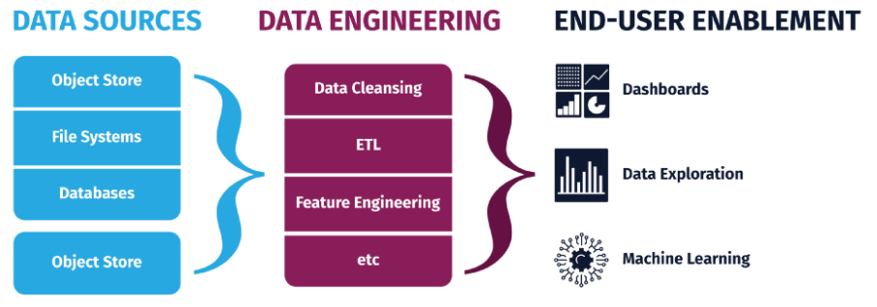
Basic Architecture For Data Engineering

Slide 3
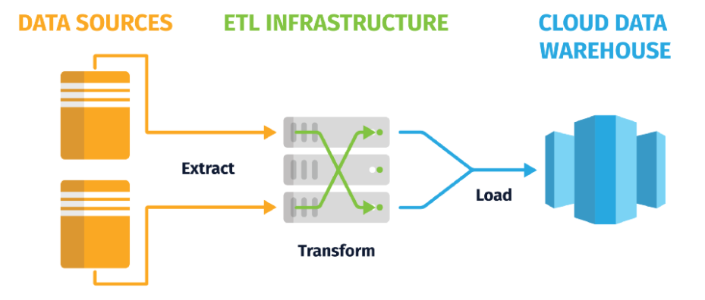
ETL Architecture

Slide 4
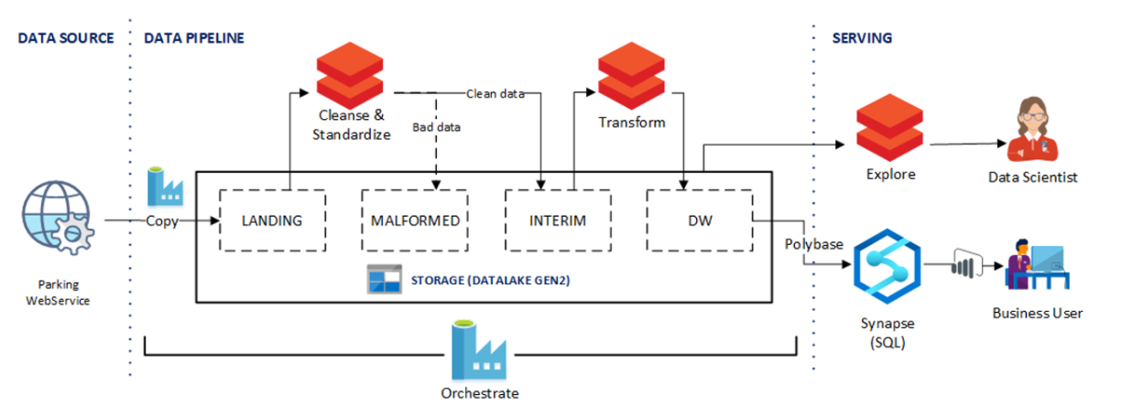
Tech Stack for the study

Slide 5
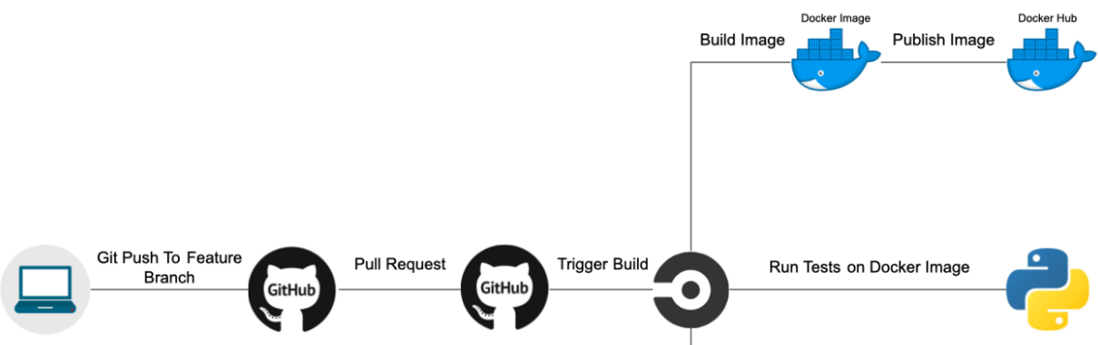
CI/CD Architecture

Slide 6
THE SUGGESTED TECH STACK
Microsoft Azure: For DE and DS
Azure Data Factory
DataBricks
ADLS- Gen2
Git: For Vesion Control
CircleCI: For CI/CD
Docker: For Containerization
Spark
Pyspark and Python

Slide 7
Please, ask your questions
Thank you.
Ashish Verma

